Slide 1
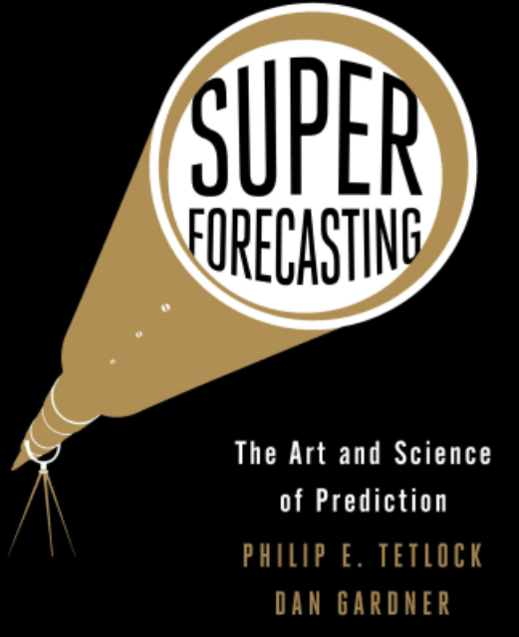
SuperForecasting Project
By: Aidan Connelly, Charlie Devin, Colby O’Brien, Riya Badoni

Slide 2
Agenda
Introduction
Research Questions
Executive summary
Addressing each forecasting question and sub-questions
Appendix

Slide 3
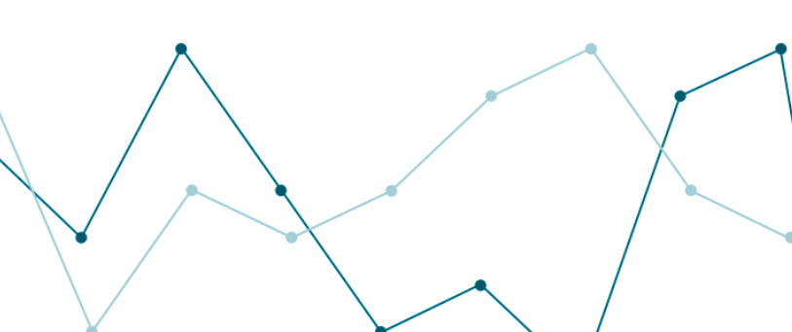
Research Questions
What will the US Holiday Season retail sales be for 2023 relative to the 2022 Holiday Season?
What will be the US civilian unemployment rate (U3 rate) by the end of 2024?
Will US covid positivity rates be higher or lower by December 31, 2024 compared to today (reference date: November 14, 2023)?

Slide 4
Summary Findings
Holiday Shopping: $984.3 billion still remains as the expected value, findings are negligible and support the statistical claim. ALMOST CERTAIN THAT IT WILL INCREASE.
Unemployment Rates: 90.63% remains the probability of the rate being higher than 3.9% by the past trends by 2024. ALMOST CERTAIN THAT IT WILL INCREASE.
Covid Positivity rates: 60.89% chance covid-19 positive test rates will be lower on December 31st 2024 than current rates at 8.2%. CHANCES ABOUT EVEN.

Slide 5

QUESTION 1
What will US holiday season retail sales be for 2023 relative to the 2022 holiday season?

Slide 6
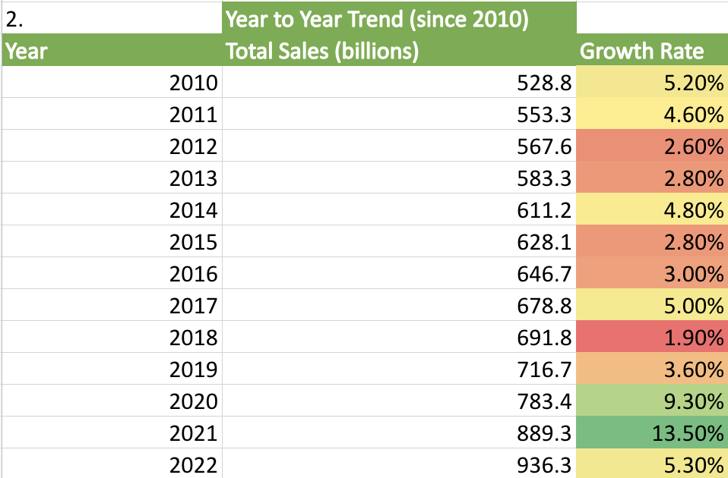
Question 1: Prior
Establishing Our Bayesian Prior
(Source Data: National Retail Federation, 2022 Holiday Sales)
2022 Holiday Sales growth rate: 5.3%
Average growth rate per year from 2010-2022: 4.95%
Statistical Expected Increased Growth Rate for 2023: 5.13%
Statistical Expected Total Sales for 2023: $984.3 billion
Given our calculations, an expected $984.3 billion will be the total for US Holiday Spending in 2023.

Slide 7
Question 1: Expanding our Forecast
Bayesian Question Cluster
What was the performance of retail sales in 2022 (Total Gross)? The 2022 Holiday Season totaled
$936.30 billion was the 2022 total
Is there a historic year to year trend that is noticeable? If so, by how much does it rise or fall?
Sales Totals rise approximately 4.95% on average, rising as high as 10%-15% depending on the year.
What time period is classified as the "holiday season"?
Thanksgiving to New Year's Day, kicking off with Black Friday, with the majority of spending tailored to Christmas. However, those last few weeks of December boast a lot of holiday celebrations, so New Year’s Day is usually when the holiday season ends.
How many times has the following year's sales been lower?
0 times. Since 2010, total holiday season sales have yet to decrease with every year that passes.

Slide 8
Question 1: Adjusting the Prior
Additional Research and Applying Cluster Findings
53.85% of the time, the growth rate increases compared to the year before. Given that 2022’s growth rate was 5.3%, and the average growth rate is 4.95%, we estimate that the growth rate for 2023 will remain about the same as the initial expected value, at 5.13%.
The yearly growth rate exceeds the average (4.95%) 30.77% of the time, with large surges above the average in 2020 (9.3%) and 2021 (13.5%). 2022 yielded a slightly above average growth rate of 5.3%.
Since the growth rate’s chances of being higher than the year prior are about even, and the fact that the growth rate rises above the average below a third of the time, we anticipate that the statistical expected growth rate and total sales projection are accurate.
FINAL FORECAST: $984.3 billion still remains as the expected value, findings are negligible and support the statistical claim, and almost certain that the total will be higher than 2022.

Slide 9

QUESTION 2
What will be the US civilian unemployment rate (U3 rate) by the end of 2024?

Slide 10
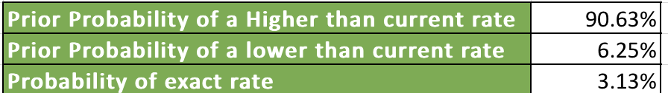
Question 2: Prior
Establishing Our Bayesian Prior :
(Source: Organisation of Economic Co-Operation and Development)
Current unemployment rate: 3.9%
Observing the given data and counting the instances of higher than, lower than, or exactly 3.9% we get following data:

Slide 11
Question 2: Expanding our Forecast
Bayesian Question Cluster
What has the unemployment rate been in years prior?
2021: 3.9% in December​​. 2022: 3.7% in October​​. 2023: Varied between 3.5% to 3.9% throughout the year, ending at 3.9% in November
What is the trend of the unemployment rate?
The trend over the past few years has been relatively stable, with slight fluctuations within the range of approximately 3.5% to 3.9%. This indicates a period of relative consistency in the labor market, with occasional minor increases and decreases in the unemployment rate.
What are markers for a rise or fall in the unemployment rate?
Increase: Economic Downturn, technological displacement, Reduced Consumer Spending, Industry-Specific Declines
Decrease: GDP Growth, New job Initiatives, Technological Innovation, Rise in Consumer Spending
How can we incorporate economic performance into our forecast for employment rates?
GDP Growth, Consumer Spending, Business Investment, Inflation Rates, Global trade
What effect does recession have on unemployment and how often do they happen?
The unemployment rate typically rises during a recession. This is due to the fact that economic downturns result in lower consumer spending, lower business revenue, and ultimately, the possibility of staff layoffs or hiring freezes. Notable recessions, for example, happened in the United States in the early 1980s, early 1990s, early 2000s (when the Dot-com bubble broke), 2007–2009 (during the Global Financial Crisis), and most recently in 2020 (due to the COVID-19 pandemic).

Slide 12
Question 2: Adjusting the Prior
Additional Research and Applying Cluster Findings
Recessions: The factors like recession, dot-com bubble burst, Monetary and Fiscal Policies, great depression, Covid-19, Global Supply Chain disruptions etc are various reasons for increase in unemployment rate in various years from 1993-2023.
Federal Reserve Bank of St. Louis: Nonfarm payroll employment is projected to slow from an average of 228,000 jobs per month in 2023 to 91,000 jobs per month in 2024. The unemployment rate is forecast to slowly drift upward to an average of 4.2% in 2024.
Congressional Budget Office: Expects employment to decline by roughly 10,000 jobs per month in 2024 before increasing by roughly 6,000 jobs per month in 2025 as economic growth rebounds.
Federal Open Market Committee (FOMC): Projects a median unemployment rate of 4.1 percent for 2024, suggesting a slight increase from the 2023 rate of 3.9% percent.
Final Forecast: 90.63% remains the probability of the rate being higher than 3.9% by the past trends by 2024. IT IS ALMOST CERTAIN THAT THE UNEMPLOYMENT RATE WILL INCREASE IN 2024.

Slide 13

QUESTION 3
Will US covid positivity rates be higher or lower by December 31, 2024 compared to today (reference date: November 14, 2023)?

Slide 14
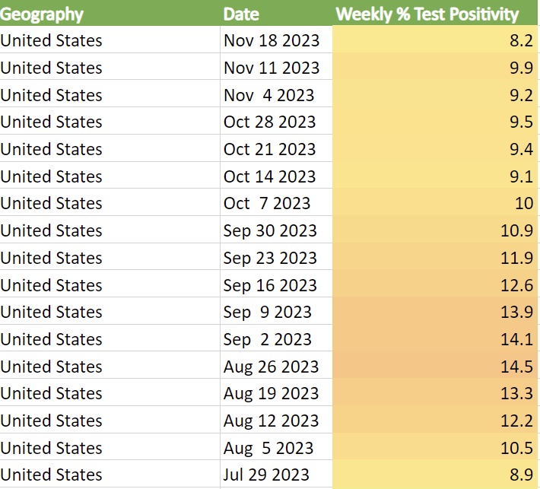
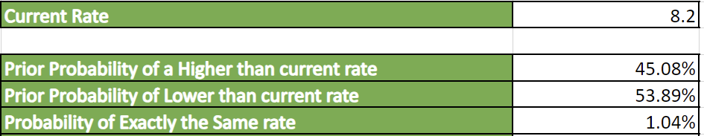
Question 3: Prior
Establishing Our Bayesian Prior:
(Source Data: CDC.gov ‘Covid Data tracker’)
Current positivity rate (Week of November 14th, 2023) = 8.2%
After examining the week to week historical data and counting the instances of higher than, lower than, or exactly 8.2% positive test rates. The following prior was returned.
53.89% being the largest probability, we establish our prior probability as there is a 53.89% probability that the positivity rate will be lower by December 31, 2024.

Slide 15
Question 3: Expanding our Forecast
Bayesian Question Cluster
What are the experts saying about the future of covid in 2024?
After examining Johns Hopkins, Yale Reports, and the CDC forecasting hub most experts are predicting a significant decline in covid-19 infections perhaps reaching endemic status. This means it should be comparable with influenza positivity rates 4.9%
Have the positivity rates been trending in either direction?
The overall trend appears to be cyclical. As for the most recent trend, since the start of September we are in a steady decline of test positivity rates.
How does seasonality affect test positivity rates, do colder months see higher positivity rates on average?
After examining the dataset it's clear that winter months (Mid December- Mid March) have an average higher test positivity rate (10.19%) than warmer months (7.98%).
What is the average test positivity rate for the calendar date of December 31st?
The average test positivity rates for the calendar date of December 31st is (12.1%) (11.3%, 2020 ; 14.4%, 2021 ; 10.6% 2022)
How do variants affect positivity rates?
With the introduction of new and widely known and contagious variants the weekly positivity rate grew every-time.

Slide 16
Question 3: Adjusting the Prior
Additional Research and Applying Cluster Findings
Yale + Pfizer + CDC: Researchers Determine Covid-19 will reach Endemic status in 2024.
Adjustment: 54.89% + 8% → 62.89%
Johns Hopkins: No evidence to strongly suggest that things are going to be much worse this coming year than they were pre-pandemic. (referring to respiratory illness season)
Adjustment: 62.89 + 3% → 65.89%
Higher Positivity Rate in Winter Months + Cyclical trend : Averaged 12.1% on previous December 31st’s. Peak→Trough→Peak→Trough trend on CDC data website.
Adjustment 65.89% - 2% → 63.89%
New Variant Emergence Possibility: There has been at least one new and impactful variant a year so far. However they tend to appear in highly concentrated waves of about a month.
Adjustment 63.89% - 3% → 60.89%
FINAL FORECAST: 60.89% chance covid-19 positive test rates will be lower on December 31st 2024 than current rates at 8.2%. CHANCES ABOUT EVEN (Kents Chart of certainty)

Slide 17
Thank YOU!
Q&A
(See next slides for citations and Appendix)

Slide 18
Citations Q1
For immediate release January 18, J. Craig Shearman, and NRF President and CEO Matthew Shay. “NRF Says 2022 Holiday Sales Grew 5.3% to $936.3 Billion.” NRF. National Retail Federation, 18 Jan. 2023. Web. 04 Dec. 2023.
Get in touch Bobby Stephens Principal | Deloitte Consulting LLP rostephens@deloitte.com . “Unwrapping 2022 Holiday Shopping Results: Deloitte Us.” Deloitte United States. Deloitte Global, 23 Jan. 2023. Web. 04 Dec. 2023.

Slide 19
Citations Q2
“Unemployment - Unemployment Rate Forecast - OECD Data.” theOECD, data.oecd.org/unemp/unemployment-rate-forecast.htm#indicator-chart. Accessed 04 Dec. 2023.
Fabino, Alexander. “Americans Face Increased Unemployment in 2024.” Newsweek, 30 Nov. 2023, www.newsweek.com/us-unemployment-rise-2024-oecd-fred-report-1848432#:~:text=Unemployment%20in%20the%20U.S.%20is,economic%20outlook%20released%20this%20week. Accessed 04 Dec. 2023.
Kliesen, Kevin L. “Slower GDP Growth and Falling Inflation in U.S. Economic Outlook for 2024.” Saint Louis Fed Eagle, Federal Reserve Bank of St. Louis, 28 Nov. 2023, www.stlouisfed.org/publications/regional-economist/2023/nov/slower-gdp-growth-falling-inflation-us-economic-outlook-2024#:~:text=Nonfarm%20payroll%20employment%20is%20projected,the%20third%20quarter%20of%202023. Accessed 04 Dec. 2023.
“U.S. Unemployment Rate 1991-2023.” MacroTrends, www.macrotrends.net/countries/USA/united-states/unemployment-rate. Accessed 04 Dec. 2023.
“Charts Related to the Latest ‘The Employment Situation’ News Release | More Chart Packages.” U.S. Bureau of Labor Statistics, www.bls.gov/charts/employment-situation/civilian-unemployment-rate.htm. Accessed 04 Dec. 2023.
“US Unemployment Rate (I:USUR).” US Unemployment Rate, ycharts.com/indicators/us_unemployment_rate. Accessed 04 Dec. 2023.

Slide 20
Citations Q3
CDC COVID-19 Data Tracker." Centers for Disease Control and Prevention, https://covid.cdc.gov/covid-data-tracker/#trends_weeklyhospitaladmissions_testpositivity_00.
"COVID-19 Forecast Hub." Viz.Covid19forecasthub.Org, viz.covid19forecasthub.org/.
FluView: Weekly U.S. Influenza Surveillance Report." Centers for Disease Control and Prevention, U.S. Department of Health & Human Services, www.cdc.gov/flu/weekly/index.htm.
Katella, Kathy. “Omicron, Delta, Alpha, and More: What to Know about the Coronavirus &nbsp;Variants.” Yale Medicine, Yale Medicine, 1 Sept. 2023, www.yalemedicine.org/news/covid-19-variants-of-concern-omicron.
"RSV, COVID-19, and Flu: Outlook for 2023-2024." Johns Hopkins Bloomberg School of Public Health, 2023, publichealth.jhu.edu/2023/rsv-covid-19-and-flu-outlook-for-2023-2024.
"Yale Researchers Predict COVID-19 Endemic Phase Will Happen in 2024." NBC Connecticut, NBC Connecticut, www.nbcconnecticut.com/news/local/yale-researchers-predict-covid-19-endemic-phase-will-happen-in-2024/2820662/.

Slide 21
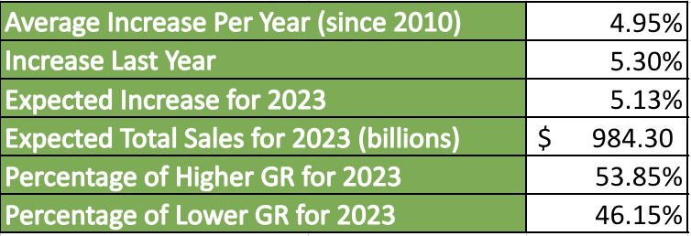
Q1 Appendix

Slide 22
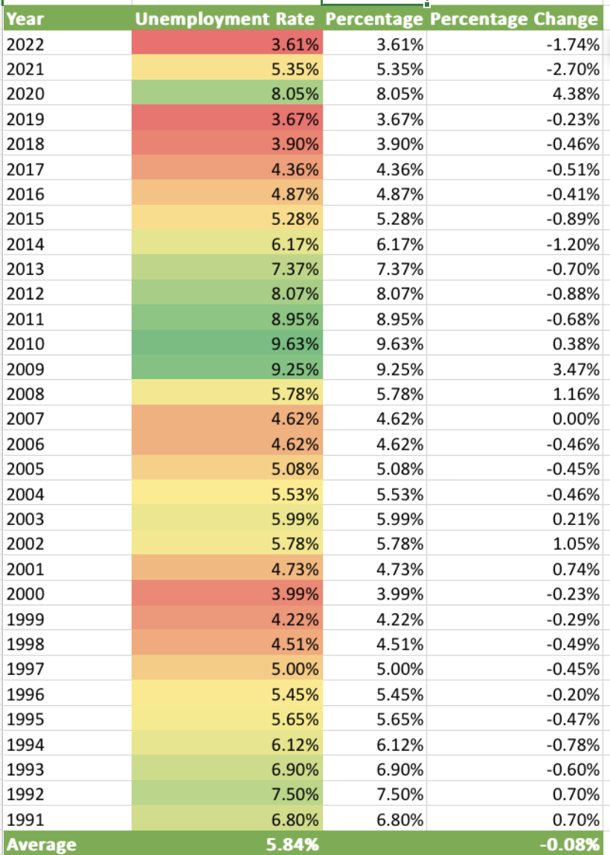
Q2 Appendix

Slide 23
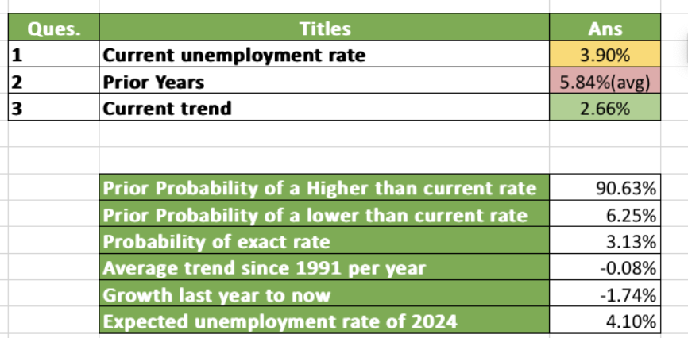
Q2 Appendix

Slide 24
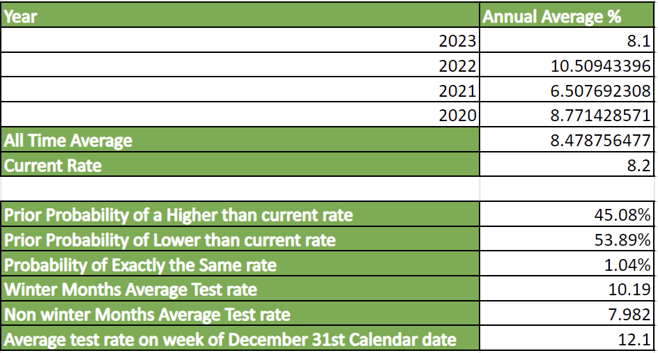
Q3 Appendix

Slide 25
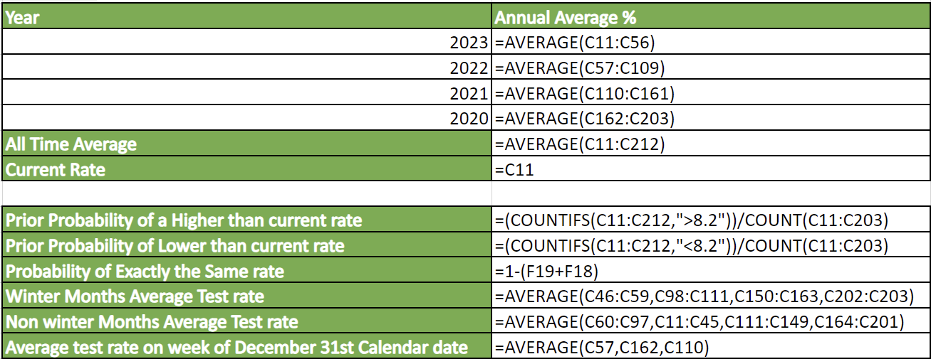

Slide 26
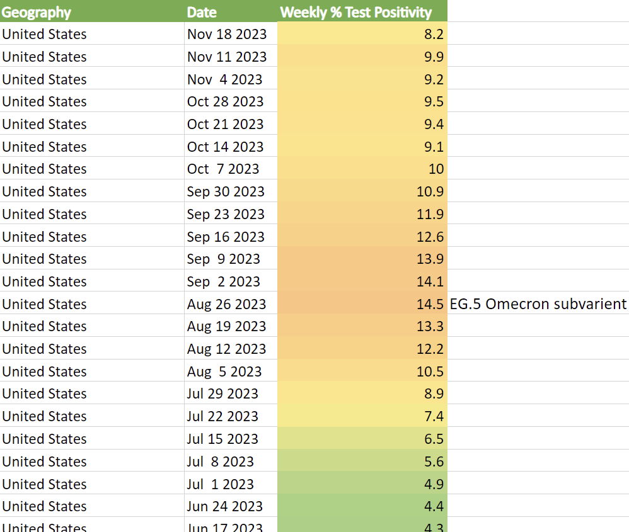
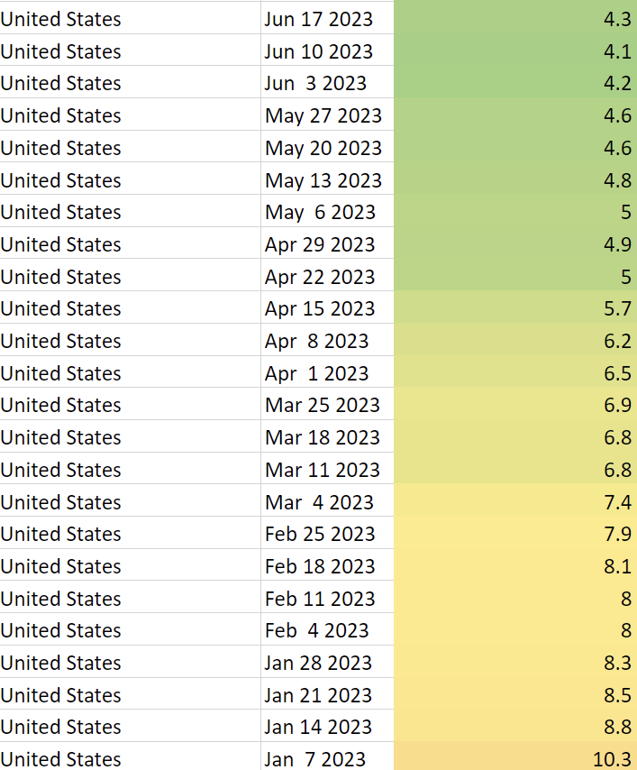

Slide 27
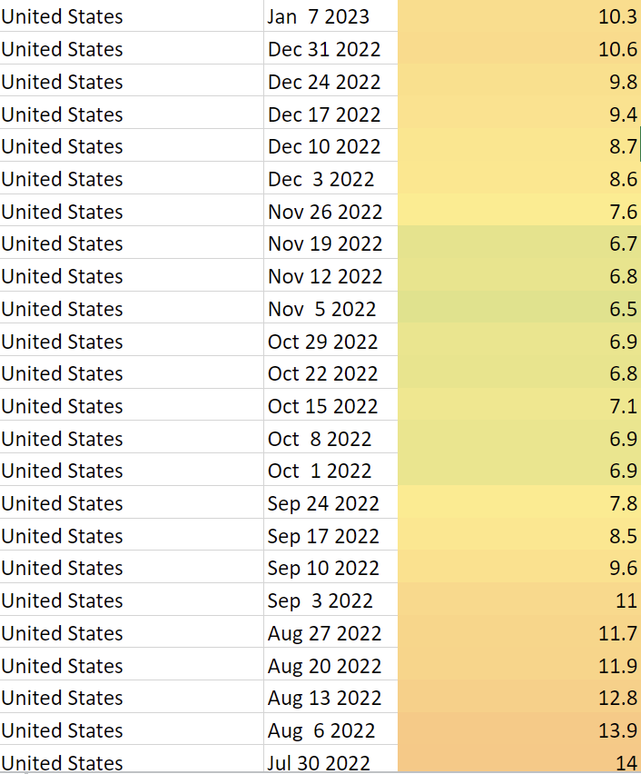
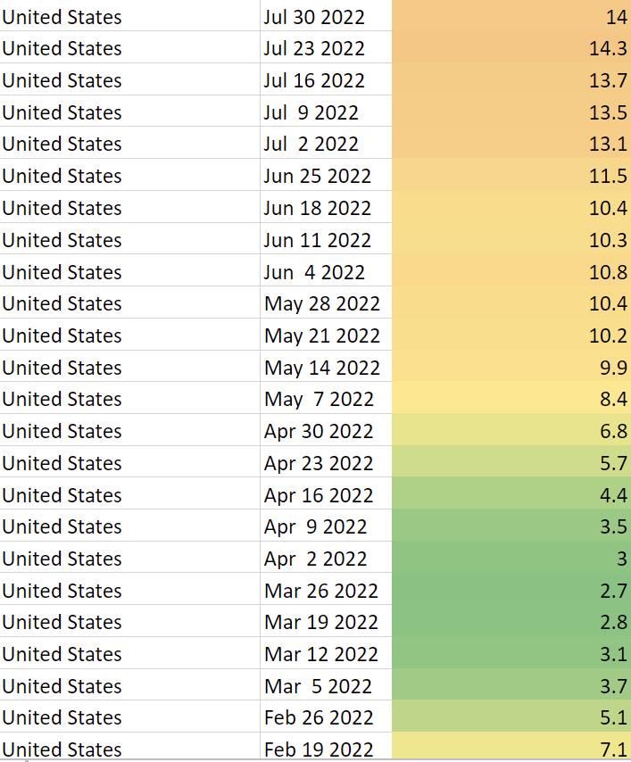

Slide 28
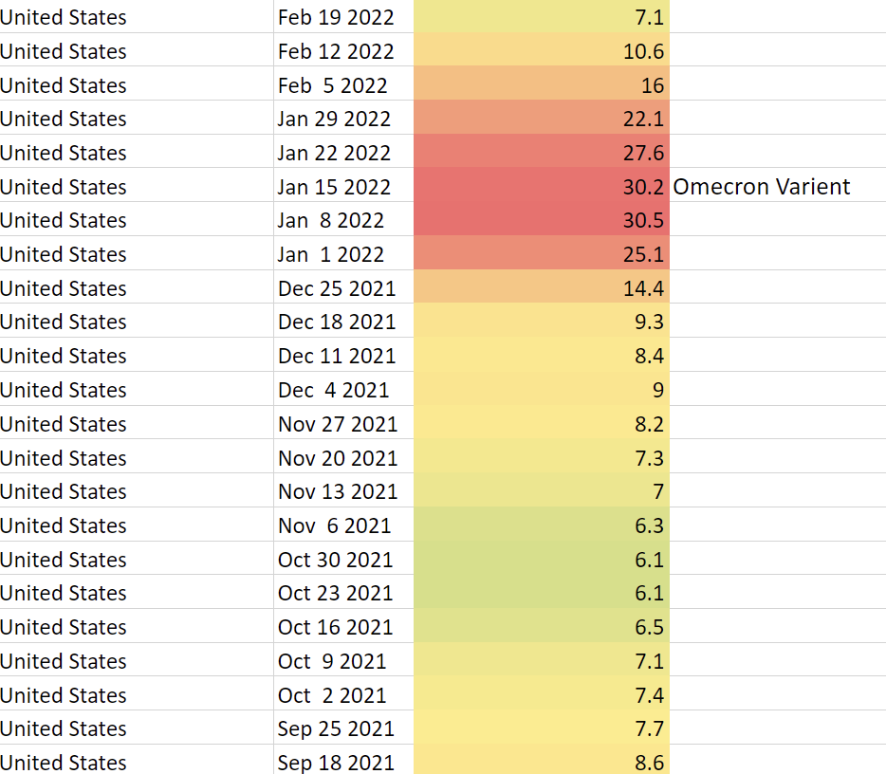
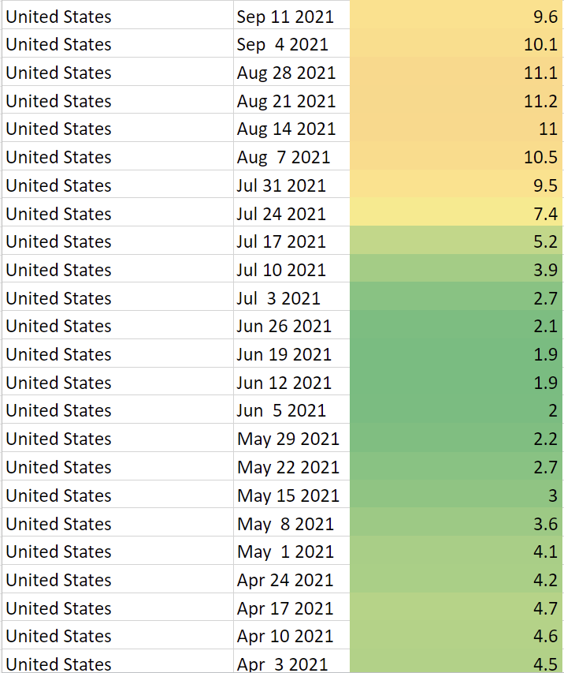

Slide 29
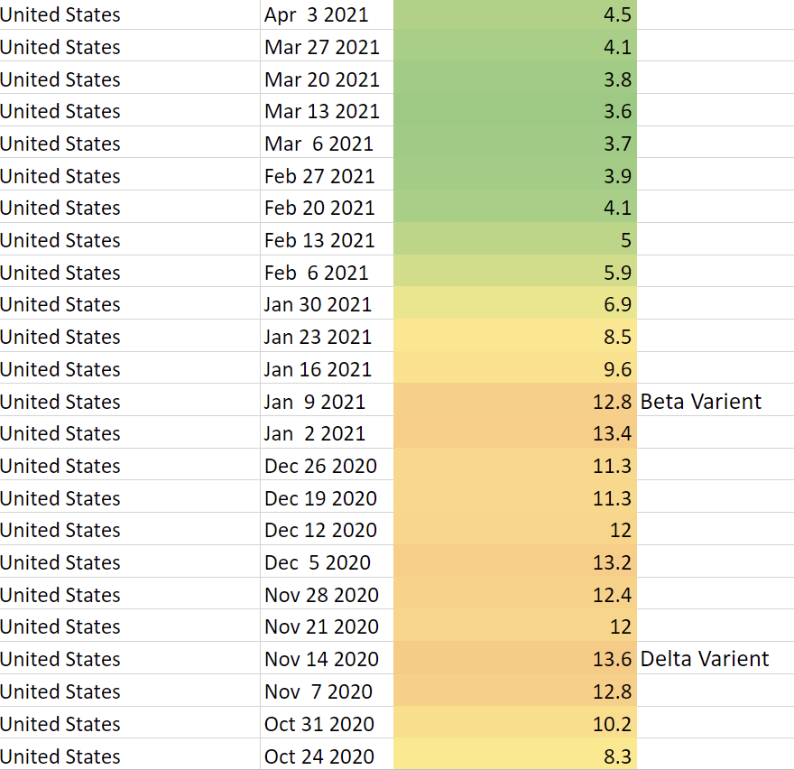
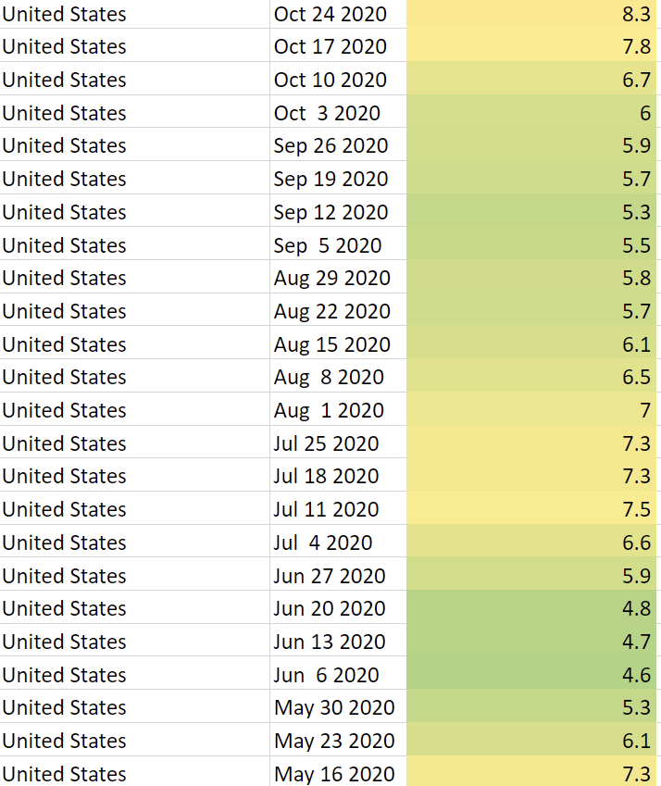

Slide 30
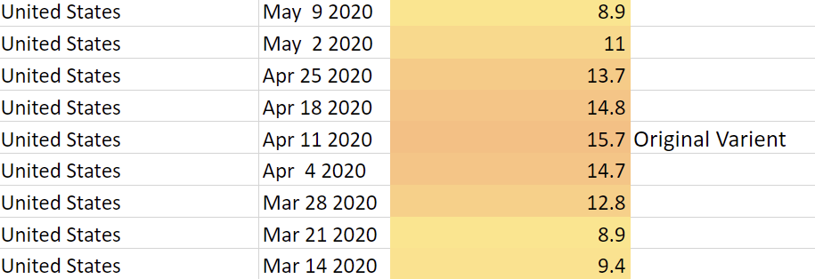
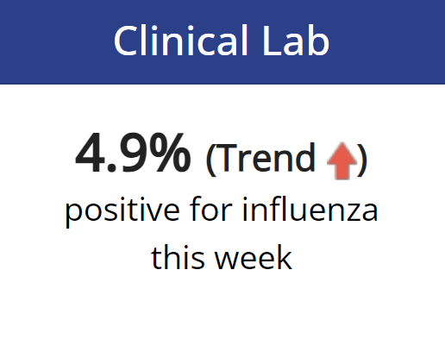

Slide 31
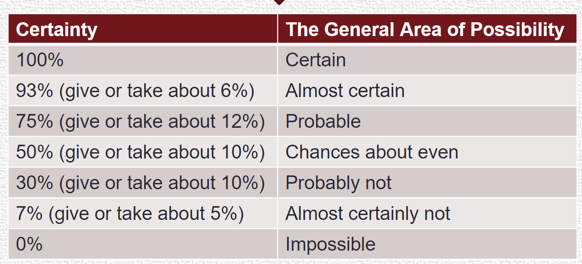
Kents Chart of Certainty

